Slide 1
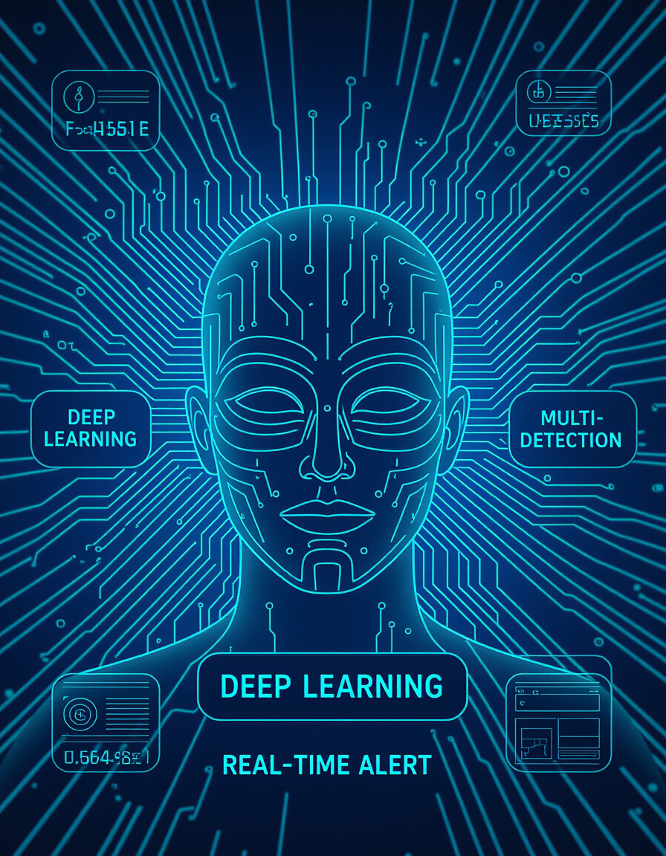

PROBLEM STATEMENT: SMART INDIA HACKATHON 2025 Internal VIT hackathon Round 1: PSID : SIH25012
Many rural schools in India rely on manual attendance systems, which are time-consuming and prone to errors.
Teachers spend significant time marking attendance, reducing instructional time.
Additionally, inaccurate records can lead to discrepancies in government reporting for schemes like mid-day meals.
This problem is prevalent in under-resourced schools with limited access to technology,
affecting administrative efficiency and student tracking.
VIT-147 (Panel – 6) 23rd September 2025 , 11:57 – 12:09

Slide 2
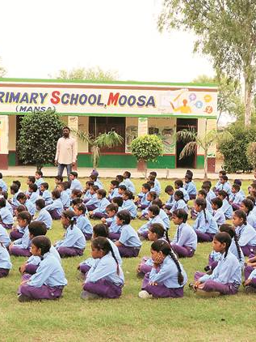
Impact / Why this problem needs to be solved
This issue affects over 50% of rural schools in PUBJAB and mostly all states,
impacting millions of students and teachers.
It leads to :
inefficiencies,
delays in reporting,
potential mismanagement of resources.
Solving this will save time, improve accuracy, and enhance resource allocation.
such that making sure every student gets equal benefits and no one is missed out.
At the same time possibly saving time which can be used more productively by staff members.

Slide 3
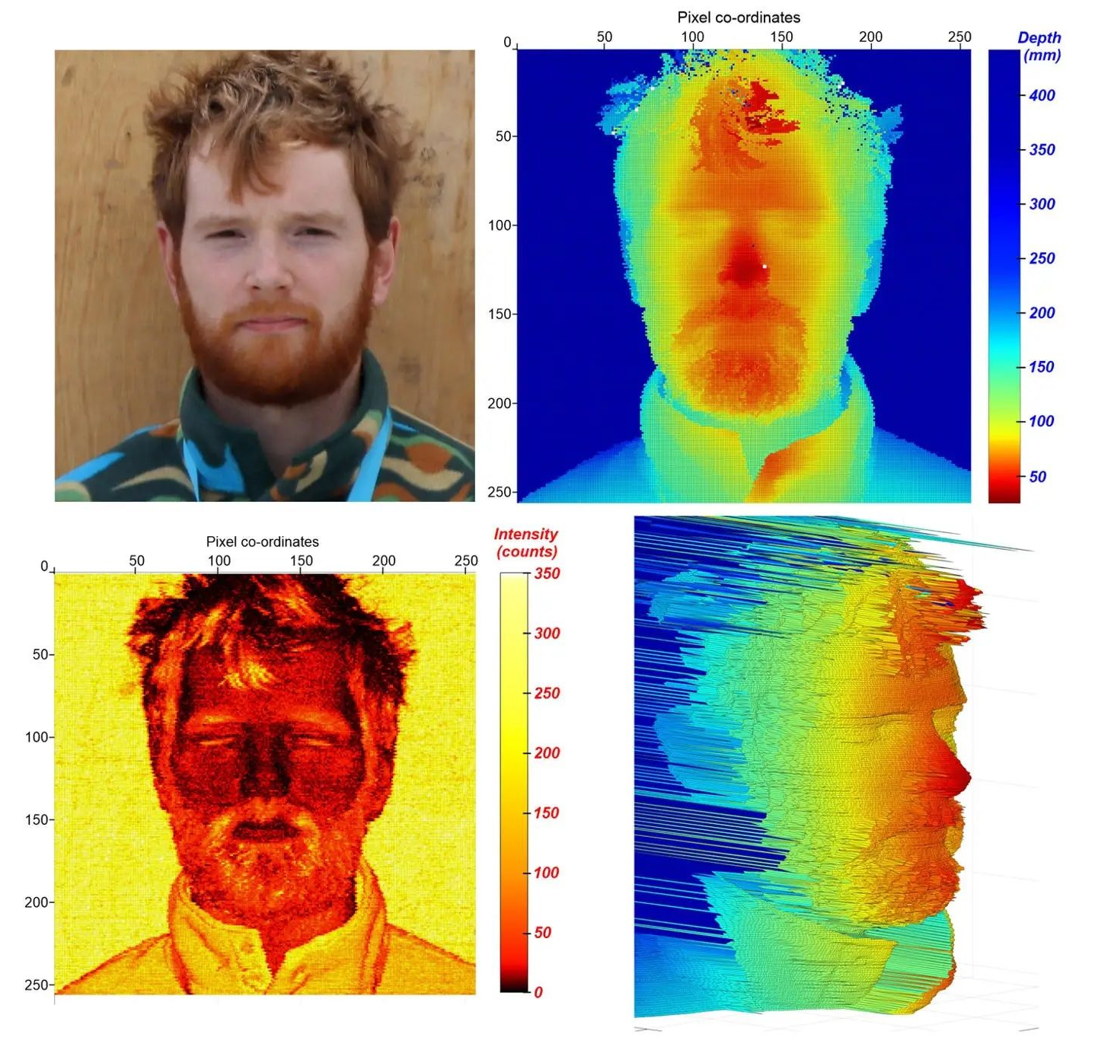
Systems already present FACIAL RECOGNITION BASED ATTENDANCE which is not a viable option here
There are many types facial recognition which is greatly expensive to be implemented in rural schools effectively and resourcefully
3D Facial Recognition ( BAD SOLUTION , EXPENSIVE )
Uses depth sensors, structured light, or infrared cameras (like Apple FaceID). - Expensive due to hardware cost
Infrared/Thermal Facial Recognition (BAD SOLUTION , High hardware + maintenance cost.)
Requires infrared cameras to capture heat signatures.
LiDAR-Based Recognition ( BAD SOLUTION , expensive )
Uses laser pulses to create a 3D face map. Costly sensors, mostly used in high-security defense
EXPENSIVE – NOT APPLICABLE TO THIS AREA
Ref : https://www.popularmechanics.com/science/a63724352/snspd-lidar-facial-recognition/

Slide 4
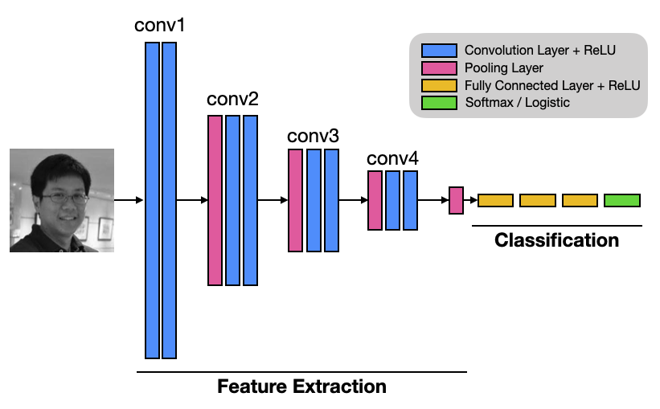
OUR METHOD : MACHINE LEARNING BASED FACIAL RECOGNITION
Particularly a subset of neural network architecture which is Convolutional Neural Network :
No Specialized Hardware Needed - Runs on commodity hardware (CPU/GPU).
Software-Only Approach - Open-source frameworks like TensorFlow/PyTorch make it nearly free.
Scalable and Flexible - Can be deployed on local machines , Doesn’t require ongoing licensing fees
Great Accuracy – achieve 95–99% accuracy on 2D photos
Its almost like magic that this works and is a viable solution to this problem
Ref : https://www.codemag.com/Article/2205081/Implementing-Face-Recognition-Using-Deep-Learning-and-Support-Vector-Machines

Slide 5
OVERALL PROJECT MECHENISM IN BRIEF
EXPLAINED WITH FLOW-MAP
04 : THE CNN MODEL FIND CONVERTS IMAGE INTO 128D VECTOR EMBEDDING
01 : THE CAMERA TAKES INPUT IMAGE
05 : EMBEDDING IS SEARCHED USING MATH SEARCH METHODS
02 : FACE DETECTION TRACKS FACE AND CROPS FACE
06 : Euclidean distance (L2 norm) (Cosine similarity is mathematically equivalent)
03 : THE CROPPED FACE IMAGE IS PUSHED INTO THE MAIN CNN MODEL
07 : THEN FINALLY IF MATCHED > 95% THEN RETURN ID TO RETRIEVE PERSON IDENTITY

Slide 6
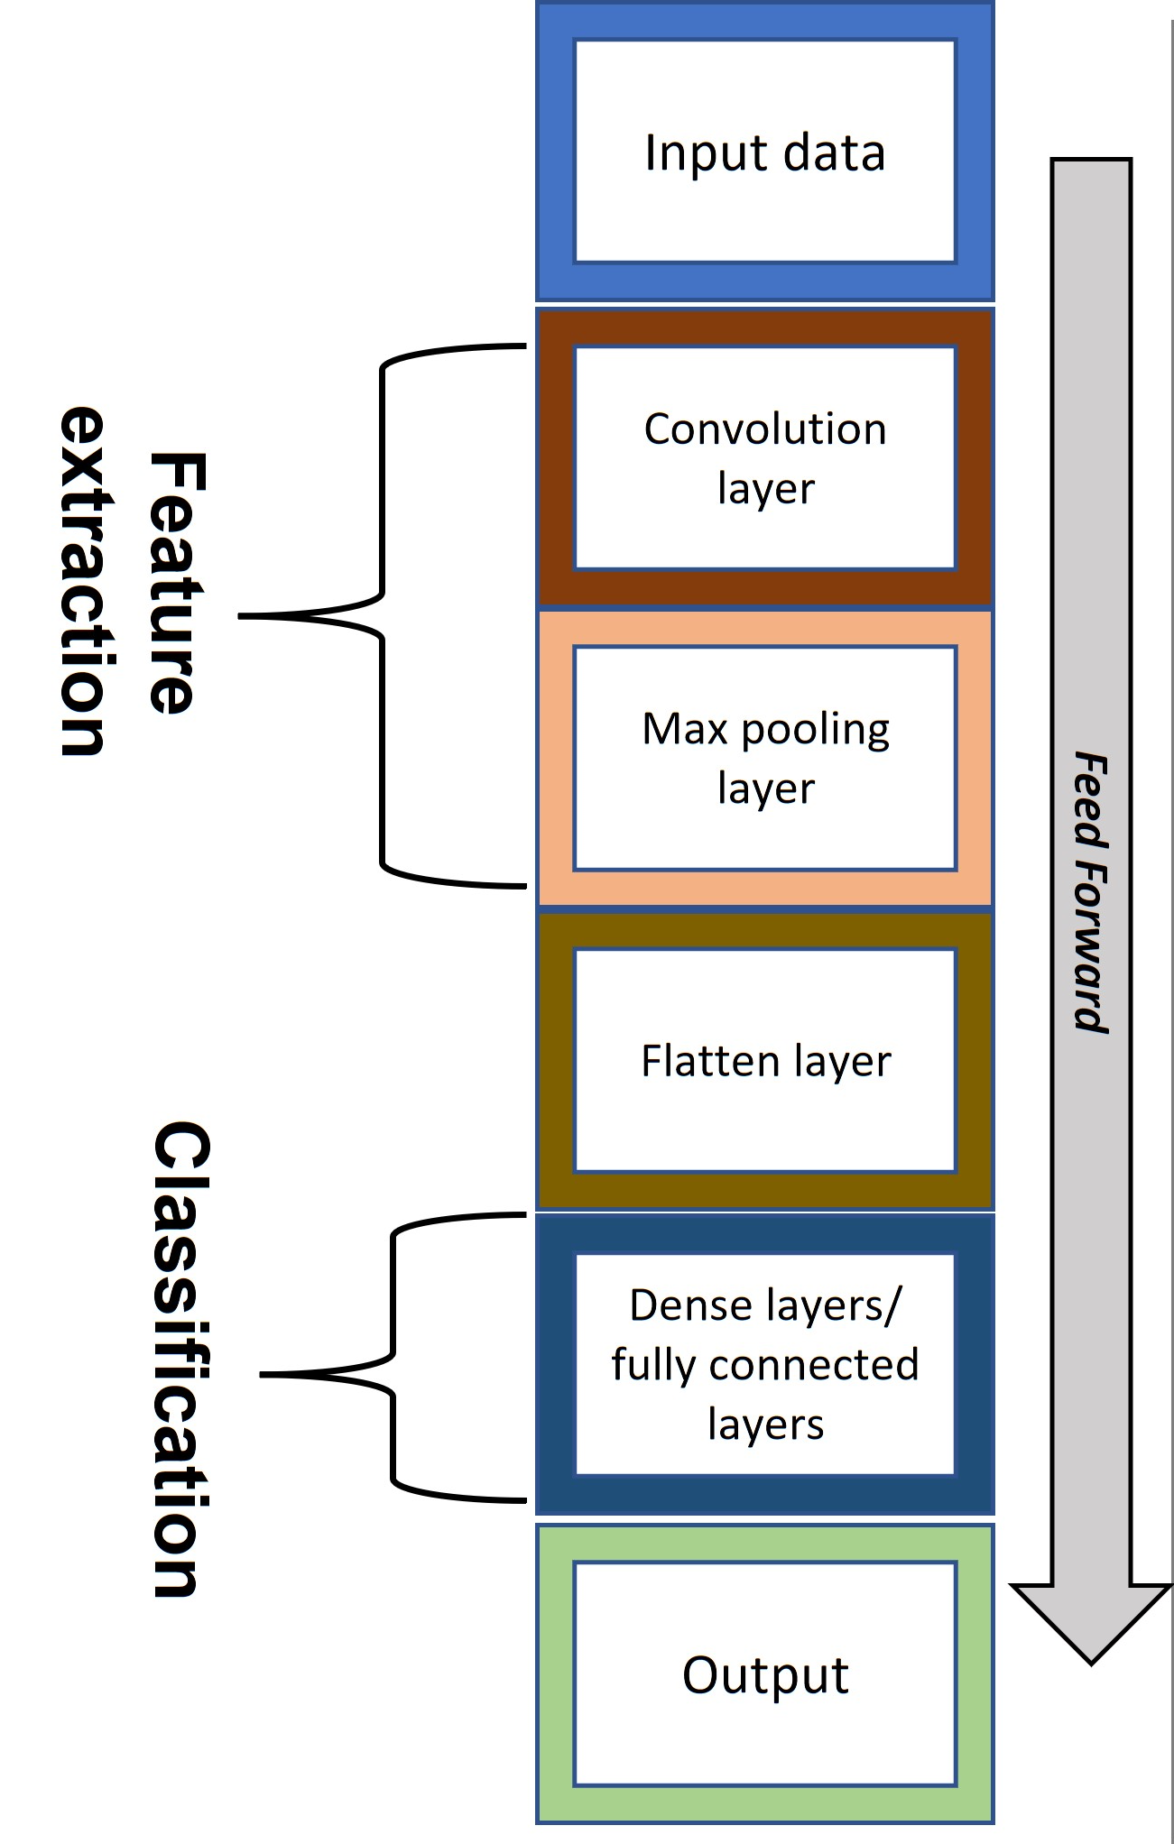
Deep Learning & The CNN Solution HOW IT WORKS ? – During Training -01
INPUT LAYER : decodes JPEG/PNG → resizes to 160×160 → AND is converted to RGB value array
Convolutional Layer 2D – 32 ,64 , 128 filters : This learns from low level features from vertical lines to high level features such as nose bridge cheekbone etc .
ReLU (inside Conv2D) - After convolution, negative pixel activations are set to 0. Keeps only useful signals , This makes sure useless features are not learned

Slide 7
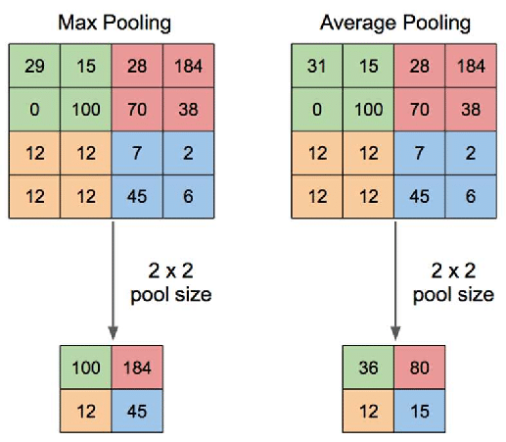
Deep Learning & The CNN Solution HOW IT WORKS ? – During Training - 02
3. Pooling Layer – These layers reduces complexity of the image after every CNN layer
Max pooling 2x2 :
layerReduces resolution (160 → 80).
Keeps strongest signals (like “yes, an edge exists here”).
Max pooling
Again reduces size (80 → 40).
Keeps only strongest activations
Global Average Pooling 2D
Converts spatial feature maps → feature vector.
Ref : https://www.researchgate.net/figure/llustration-of-Max-Pooling-and-Average-Pooling-Figure-2-above-shows-an-example-of-max_fig2_333593451

Slide 8
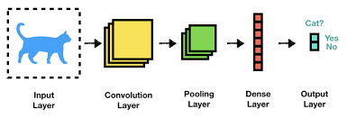
Deep Learning & The CNN Solution HOW IT WORKS ? – During Training - 03
4. Dense Layer : This layer is fully connected to the final output layer and learns to mix features into a 128-dimensional embedding
Each dimension represents some hidden “face feature.” Examples:
Distance between eyes
Skin tone contrast
Nose width, lip thickness, etc.
It doesn’t label them explicitly → but mathematically, this 128-d vector becomes your face signature. ( THE UNIQUENESS OF EVERY FACE from perspective of the model )

Slide 9
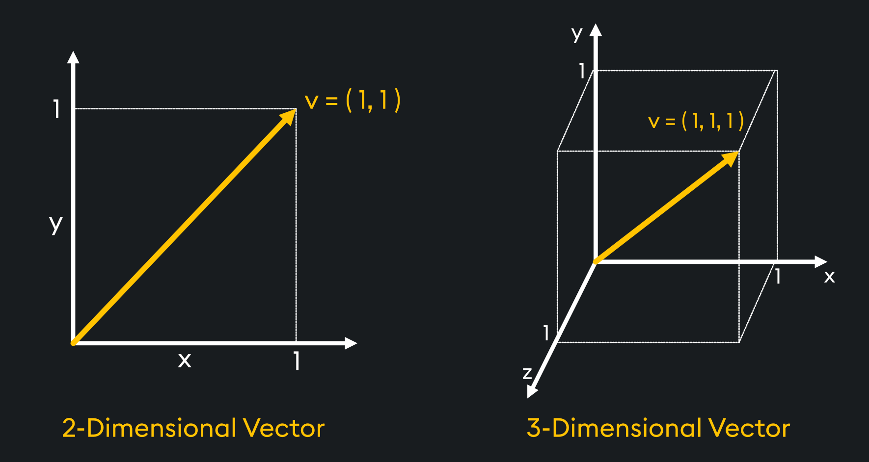
Deep Learning & The CNN Solution HOW IT WORKS ? – During Training - 04
5. Final Conclusion : The Model dosent learn to know who is who rather it learns to store any image into a special position in the multi dimensional space where each axis represents a certain feature which is called vector embedding
Next time when we want to search for a face
What model does is convert image into best embedding location
we do a vector based mathematical search for a new face to search for the closest matching features
WE DECIDE A THRESHOLD :
IF MATCH >= 95 % then FACE MATCHES IN DATA:
ELSE NOT MATCHED
BUT RATHER THAN 3D we have 128D vector space where model stores an image using the training.

Slide 10

DATASET USED IN TRAINING
LINK : https://www.kaggle.com/datasets/stoicstatic/face-recognition-dataset
SOURCE : Nikit Periwal - KAGGLE
LICENSE - CC0 1.0 Universal CC0 1.0 Deed
No Copyright
The person who associated a work with this deed has dedicated the work to the public domain by waiving all of his or her rights to the work worldwide under copyright law, including all related and neighboring rights, to the extent allowed by law.
You can copy, modify, distribute and perform the work, even for commercial purposes, all without asking permission. See Other Information below.

Slide 11
FUTURE ASPECTS & GOALS - 01
We plan to add alot of features in the final product such as :
END TO END ENCRYPTION : This ensures that data of every staff and student is protected upto military standards , we will encrypt the embedding set using best encryptions available and also look upto quantum proof encryption as our further research focus.
BLOCKCHAIN : This ensures that no fake data can be generated in the embedding and only the real identity is verified so no resource allocated is cheated and everyone gets fair and equal resources with no shortage.
Smarter System : Implemetation of LLM (Large Language Model) based monitoring over the data will keep it more automated and reliable and also to communicate with students in regional languages to provide instructions live based on the situation.
And a lot more …

Slide 12
FUTURE ASPECTS & GOALS - 02
PARENT – STAFF APP : We plan to provide integrated app linked with the system that gives live updates about which student is present and which student is out of the classroom with respect to timing.
CUSTOMISED OPTIONS : We plan to add custom options for special occasions such as EVENTS , MID-DAY MEALS , etc. Which will be super easy to edit by a faculty using the user interface
DISASTER PROOF : If one server goes down (due to earthquake, fire, flood, or hardware failure), the system automatically fetches data from another location. ( ALSO sends immediate alerts using siren and noise about the disaster to alert everyone nearby )

Slide 13

USER INTERFACE PROTOTYPE & PLANS
We plan to keep it :
FUN and shouldn’t feel like a chore to scan
Will provide with special quotes unique with each person
Vibrant and colorful design (non tech design)
Jagran free approach to feel relatable and personalized
Use of religional languages into the system
Fun animations and smooth experience
THIS IS JUST A PROTOTYPE – WE PLAN TO PROVIDE MUCH BETTER DESIGN

Slide 14
THANK YOU
Hope this provides a real impact and solves the problem not just in theory but in live application
We Aim to provide much more than what we could show here in limited space

